Slide 1
Problem Statement : Water Quality Predictive Analysis
Drinking Water Portability

Slide 2
Context
Access to safe drinking-water is essential to health, a basic human right and a component of effective policy for health protection. This is important as a health and development issue at a national, regional and local level. In some regions, it has been shown that investments in water supply and sanitation can yield a net economic benefit, since the reductions in adverse health effects and health care costs outweigh the costs of undertaking the interventions.

Slide 3
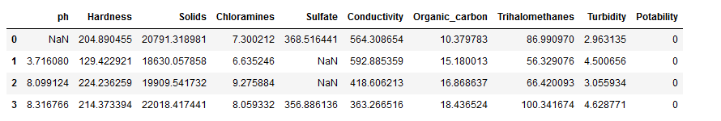
Content
The water_potability.csv file contains water quality metrics for 3276 different water bodies.

Slide 4
Feature Variables – Input -1
1. pH value: PH is an important parameter in evaluating the acid–base balance of water. It is also the indicator of acidic or alkaline condition of water status.
2. Hardness: Hardness is mainly caused by calcium and magnesium salts. These salts are dissolved from geologic deposits through which water travels.
3. Solids (Total dissolved solids - TDS): Water has the ability to dissolve a wide range of inorganic and some organic minerals or salts such as potassium, calcium, sodium, bicarbonates, chlorides, magnesium, sulfates etc.
4. Chloramines: Chlorine and chloramine are the major disinfectants used in public water systems. Chloramines are most commonly formed when ammonia is added to chlorine to treat drinking water.
5. Sulfate: Sulfates are naturally occurring substances that are found in minerals, soil, and rocks. They are present in ambient air, groundwater, plants, and food.
6. Conductivity: Pure water is not a good conductor of electric current rather’s a good insulator. Increase in ions concentration enhances the electrical conductivity of water
7. Organic_carbon: Total Organic Carbon (TOC) in source waters comes from decaying natural organic matter (NOM) as well as synthetic sources

Slide 5
Feature Variables – Input -2
8. Trihalomethanes: THMs are chemicals which may be found in water treated with chlorine. The concentration of THMs in drinking water varies according to the level of organic material in the water, the amount of chlorine required to treat the water, and the temperature of the water that is being treated.
9. Turbidity: The turbidity of water depends on the quantity of solid matter present in the suspended state. It is a measure of light emitting properties of water and the test is used to indicate the quality of waste discharge with respect to colloidal matter.
10. Potability: Indicates if water is safe for human consumption where 1 means Potable and 0 means Not potable.

Slide 6
FEATURE ENGINEERING – Steps Involved Treating the Missing Values
Data That can be missing can be of two types : 1) Continuous Data 2) Discreate Or Categorical Data
The Types of missing can be of mentioned types :
1) MCAR - Missing Completely At Random - If the probability of being missing is same for all the observations. 2) MNAR - Missing Not At Random - There is some relationship between the missing data 3) MAR - Missing At Random – No Relationship on Missing Data

Slide 7
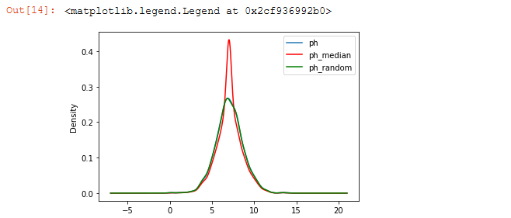
Random Sample Imputation
Aim: Random sample imputation consists of taking random observation from the dataset and we use this observation to replace the nan values
When should it be used? It assumes that the data are missing completely at random(MCAR). The Below graph explains the feature data imputation wrt original data for random as well as median value.

Slide 8
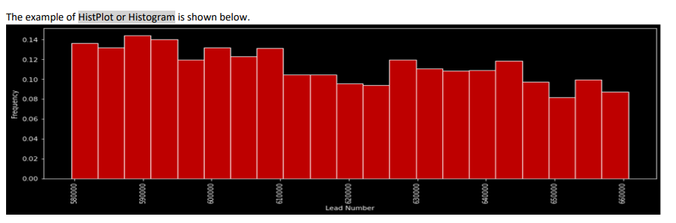
Data Analysis - Univariate And Bivariate Analysis
Once we data preparation stage is completed. Analysis of the data is the next most important step. Broadly, the data analysis or data visualization can be broadly classified into two steps:
1) Univariate Analysis 2) Bivariate Analysis
Univariate Analysis is performed on the simple variable to find it’s density, count , frequency etc. In this case study , histogram and box plot is used.
Histogram : Histogram is used to find out the density or frequency of the data spread across the X-axis.

Slide 9
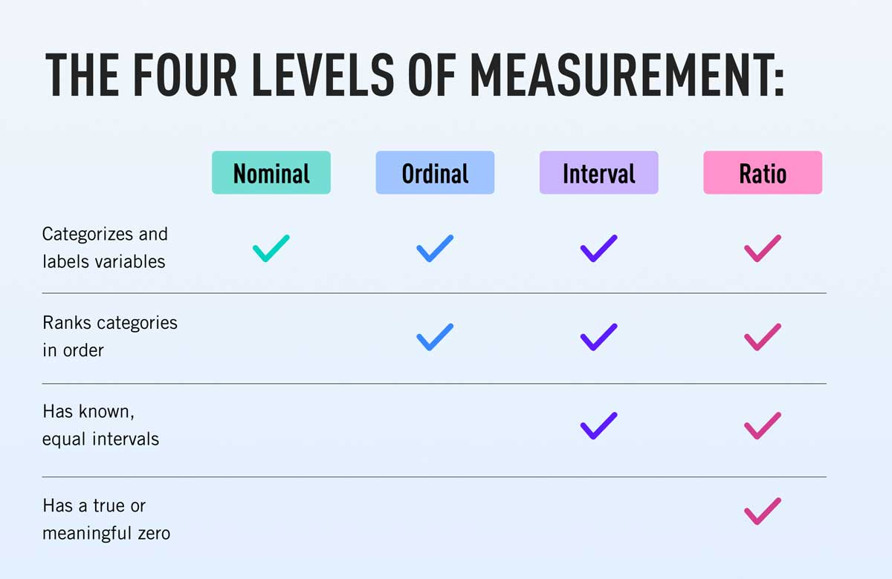
Encoding
Every Algorithm accepts Numerical value . The Algorithm are instantiated as model using python libraries. Encoding is done for :
1. Nominal Values
2. Ordinal Values

Slide 10
Normalization And Standardisation
The Commonly Used Scaler are :
1. Standard Scaler 2. Min Max Scaler
The Latest Scaler Recommended Is :
Robust Scaler
It is used to scale the feature to median and quartiles . Scaling using median and quantiles consists of subtracting the median to all the observations, and then dividing by the interquartile difference. The interquartile difference is the difference between the 75th and 25th quartile:
IQR = 75th quantile - 25th quantile
X_scaled = (X - X.median) / IQR

Slide 11
Guassian Transformation
Some machine learning algorithms like linear and logistic assume that the features are normally distributed –The skewed features is required to be transformed which is called Gaussian Normal Distribution
Some of the Techniques are :
logarithmic transformation
reciprocal transformation
square root transformation
exponential transformation (more general, you can use any exponent)
boxcox transformation

Slide 12
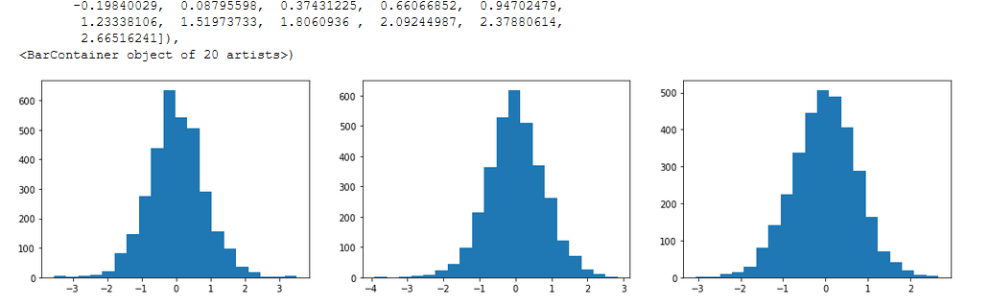
Example Of Normal Distribution Dataset

Slide 13
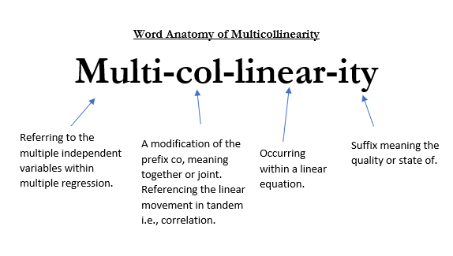
Multi Collinearity

Slide 14
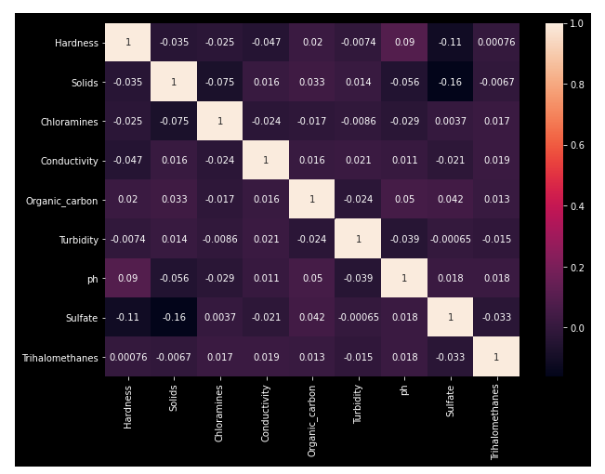
HeatMap Representation Of Multi Collinearity

Slide 15
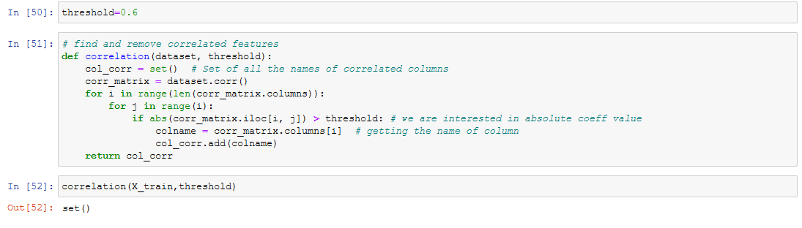
Reduction Of Variables With High Multi Collinearity
The Threshold Value has to be determined from the HeatMap used to represent the data. The MultiCollinear Values are required to be excluded to determine non-biased predicted result
Example :

Slide 16
Outlier Treatment
Perhaps the most important hyperparameter in the model is the “contamination” argument, which is used to help estimate the number of outliers in the dataset. This is a value between 0.0 and 0.5 and by default is set to 0.1.
Isolation Forest
Isolation Forest, or iForest for short, is a tree-based anomaly detection algorithm.
It is based on modeling the normal data in such a way as to isolate anomalies that are both few in number and different in the feature space.
for reference, https://machinelearningmastery.com/model-based-outlier-detection-and-removal-in-python/

Slide 17
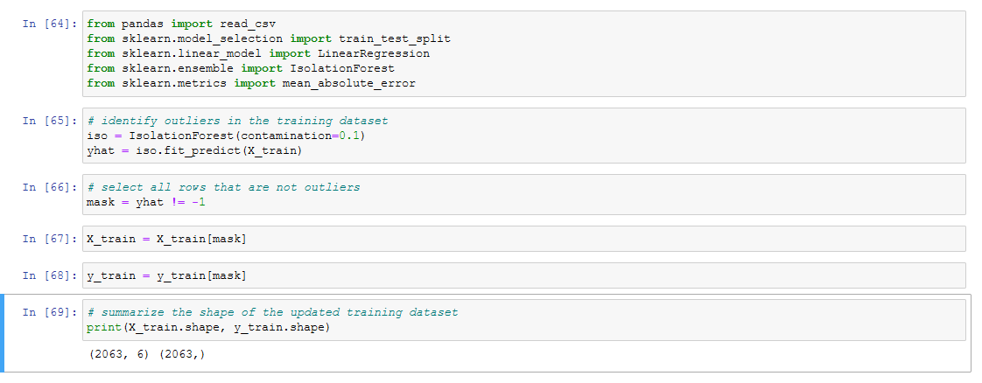
Example To Treat Outliers Using Isolation Forest Techniques

Slide 18
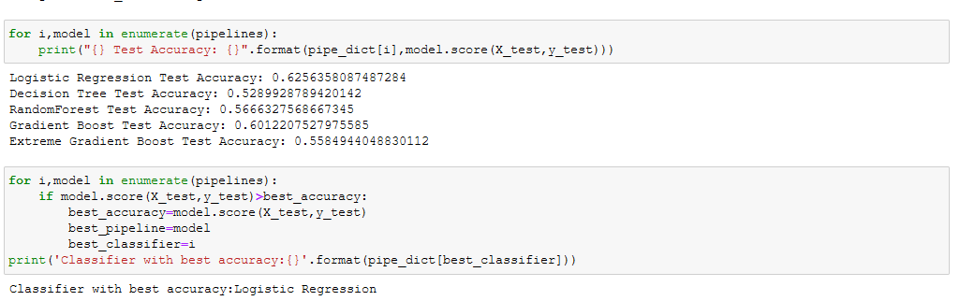
Pipeline Creation
It is cv (cross validation techniques) that can be done on a sample data from the original dataset to check which algorithm best fit for the dataset.
Example:

Slide 19
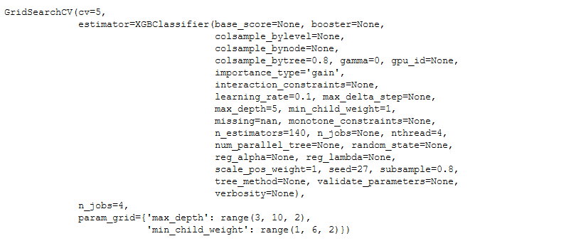
Hyper Parameter Tuning
Once the algorithm is selected , it parameter is required to be optimized in accordance to the behavior of the data. The best techniques recommended are :
1. RandomizedSearchCV 2. GridSearchCV
Example

Slide 20
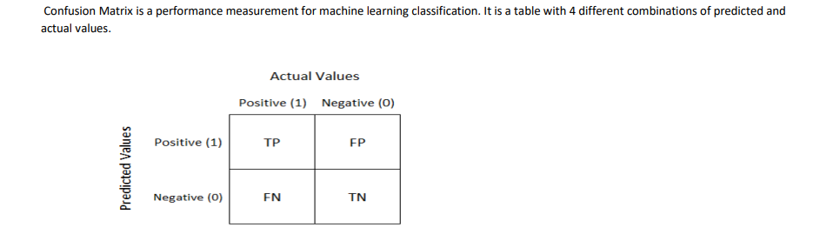
Plotting the Confusion Matrix

Slide 21
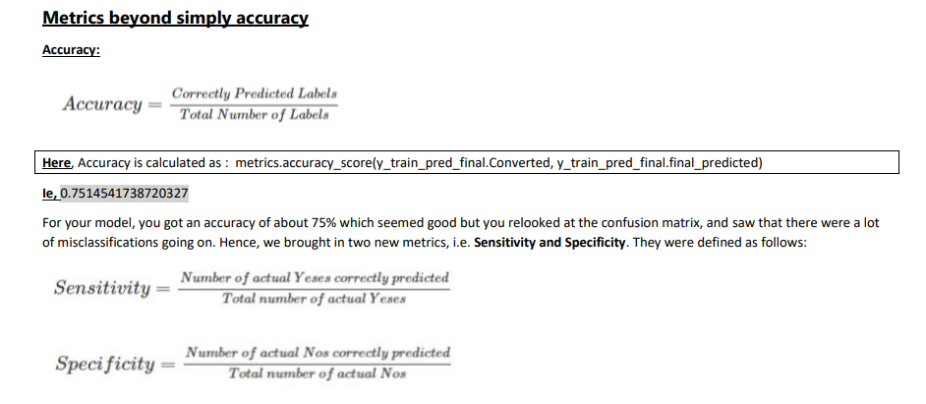
Important Metrices Calculated From the Confusion Matrix

Slide 22
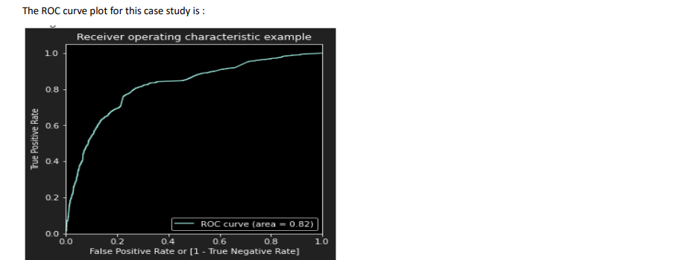
ROC CURVE
An ROC curve demonstrates several things:
It shows the tradeoff between sensitivity and specificity (any increase in sensitivity will be accompanied by a decrease in specificity).
The closer the curve follows the left-hand border and then the top border of the ROC space, the more accurate the test.
The closer the curve comes to the 45-degree diagonal of the ROC space, the less accurate the test.

Slide 23
Further Consideration – End To End Web ML Creation
1. Creating GUI or Web Interactive Form where the necessary input data can be provided to get or check the predicted result Of classification problem. Eg : Drinking/Non- Drinking Water.
This will include :
1. Web UI – In HTML Or CSS
2. ProcFile – Explaining where it is to be deployed
3. Requirement.txt – it should consist of the python libraries name and it’s versions used for the problem.
4. app.py – that can be used to extract the values from the web form and the calculcate it wrt, the model created.
5. Pickle File (.pkl) – The binary file of the model created . This file is required to be present in the web server.
6. Platform - Web Server Or Clould Server – like Heroku , GCP – Google Cloud Platform
7. DNS - .com or .edu for which the Web ML is used.

